Slide 1

clasification hand-written digits using KNN
Husna Satira

Slide 2

Abstract
Handwritten digit recognition is a fundamental problem in machine learning and computer vision, often used as a benchmark for classification algorithms. This study leverages the sklearn.datasets.load_digits dataset, which contains images of handwritten digits (0-9) in an 8x8 grayscale format. The goal of this project is to classify these digits accurately using different machine learning models and compare their performance based on accuracy and computational efficiency. Various preprocessing techniques, feature extraction methods, and classification algorithms are implemented to achieve an optimal model for digit recognition.

Slide 3
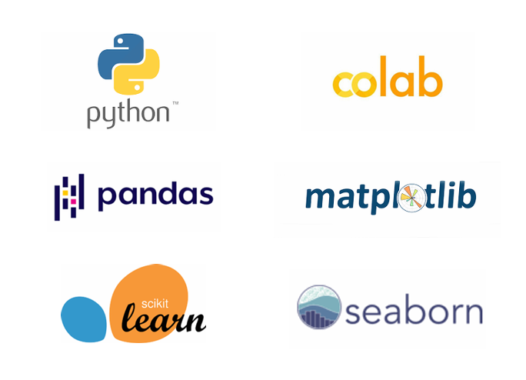
Tools & Library

Slide 4
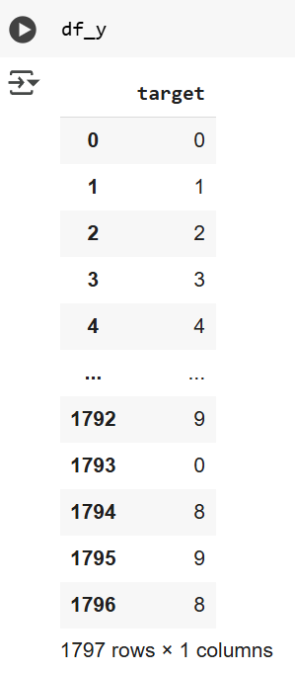
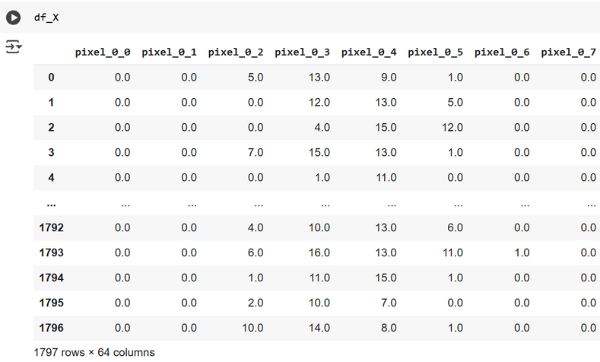
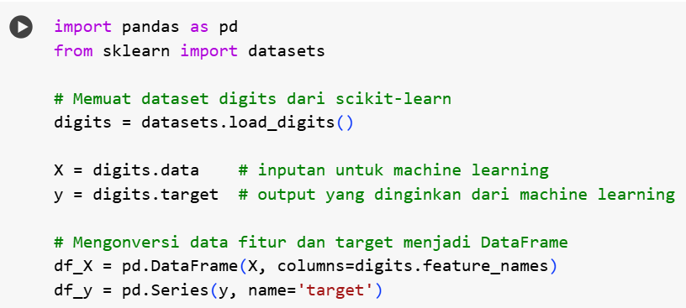
READ DATA
The read data step above was performed by loading the Digits dataset from Scikit-learn into a DataFrame format using the Pandas library. This dataset consists of 1,797 entries with 65 columns (64 pixel intensity features and 1 target label). Each feature column represents a pixel value from an 8x8 grayscale image, with values ranging from 0 to 16, while the target column contains integer labels (0-9), representing the digit in the image. After reading the data, the first few rows are displayed to provide an overview of the dataset structure.

Slide 5
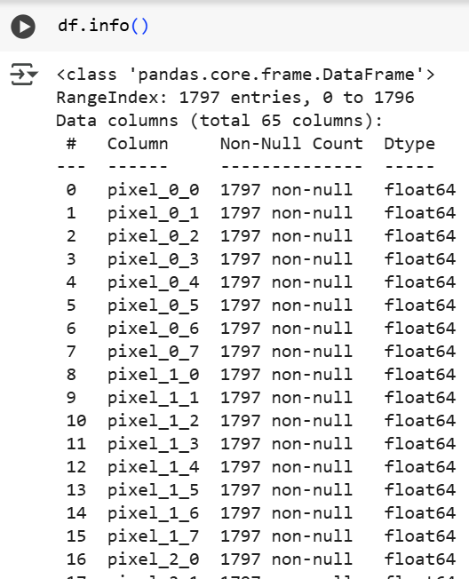
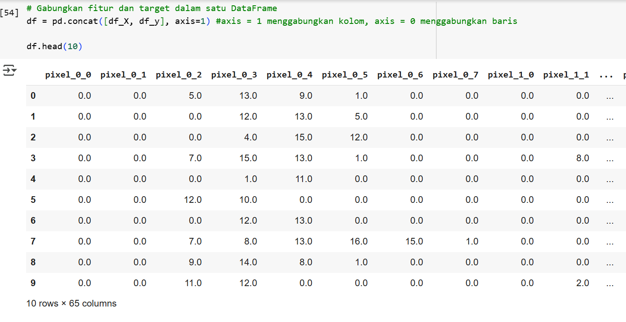
READ DATA

Slide 6
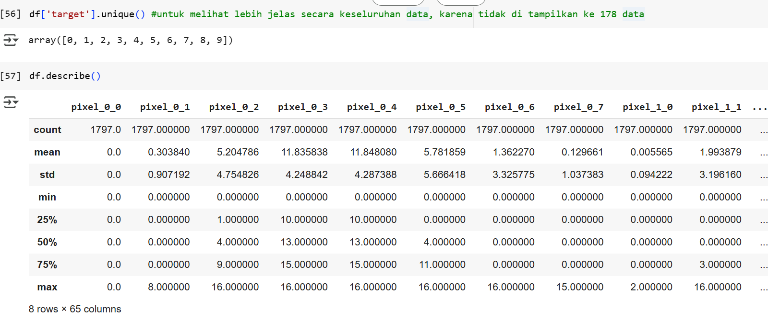
READ DATA

Slide 7
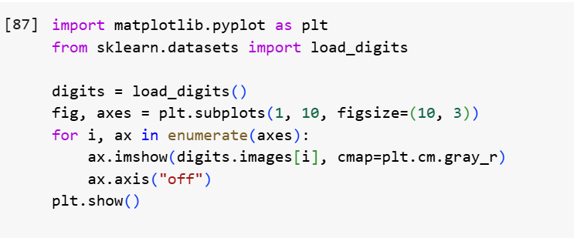
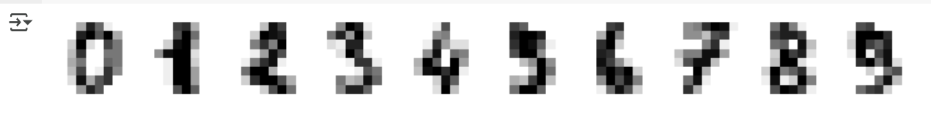
Exploratory Data Analysis (EDA)

Slide 8
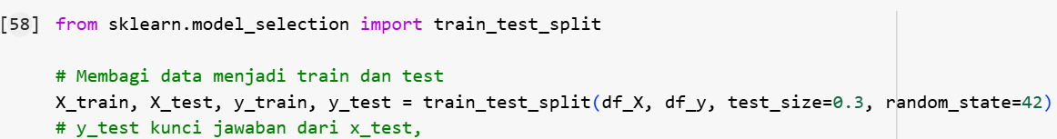
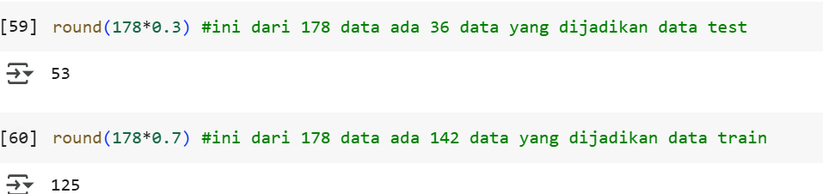
Splitting Data
split data : 70% data train
30% data test

Slide 9
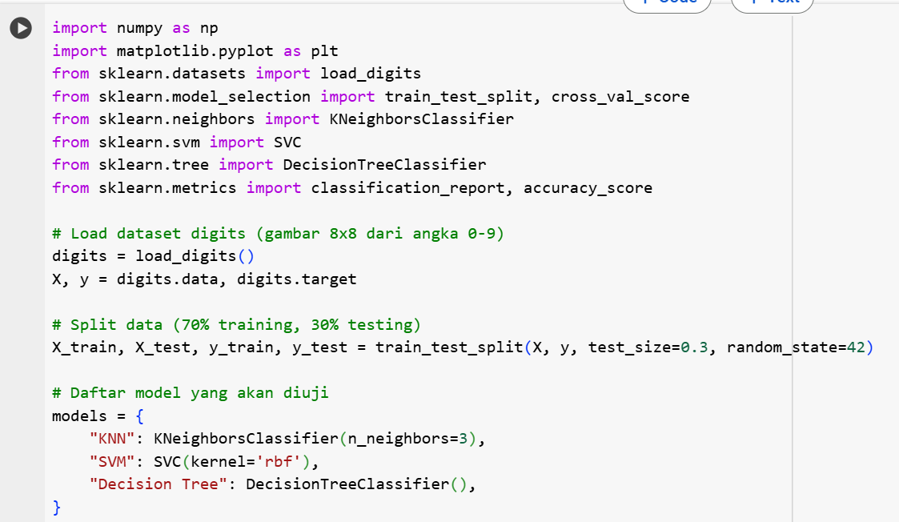
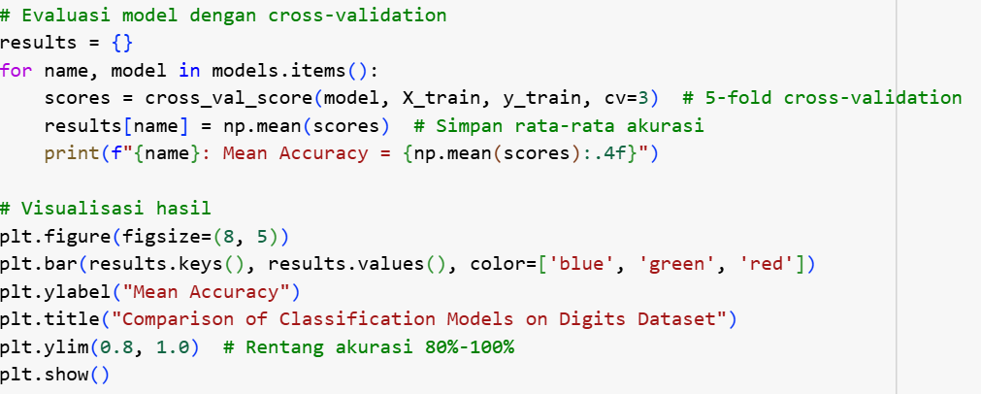

Train the Model
Comparing several classification models on the Digits dataset from sklearn.datasets.load_digits(). This code will use K-Nearest Neighbors (KNN), Support Vector Machine (SVM), and Decision Tree, , then compare their accuracy using cross-validation.

Slide 10
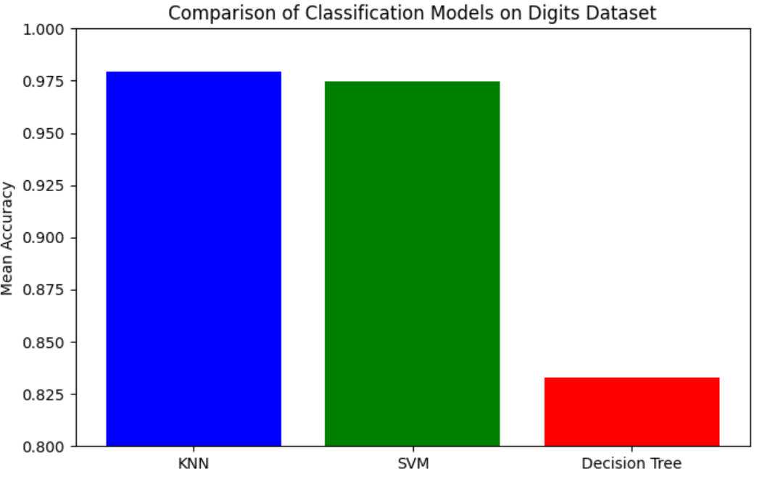
Train the Model

Slide 11
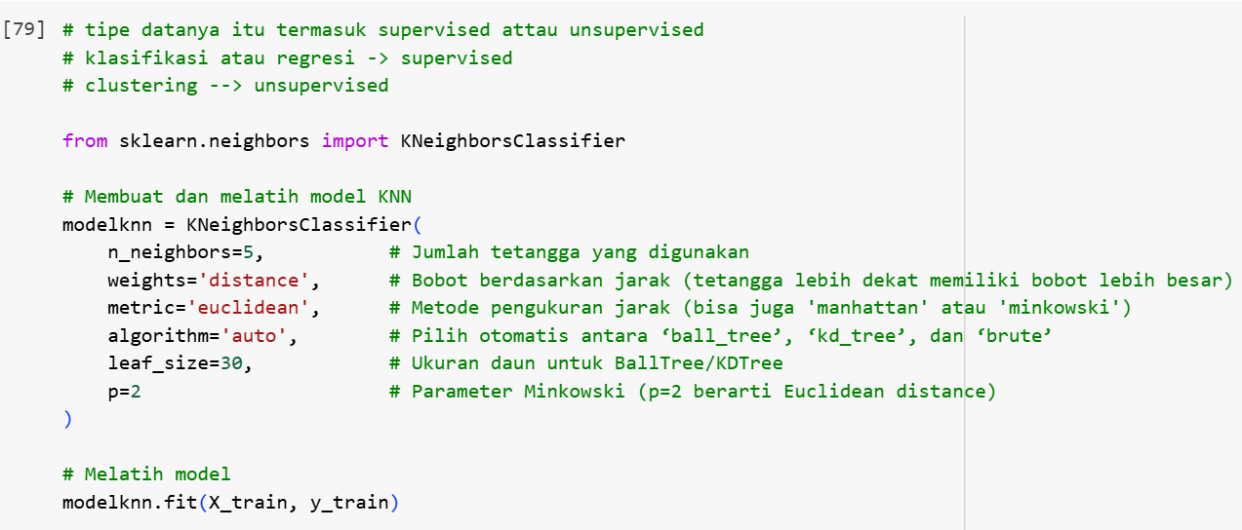

Train the Model
The Split Data & Train the Model step trains a K-Nearest Neighbors (KNN) classifier using 5 neighbors, distance-based weighting, and Euclidean distance. The model is then fitted with modelknn.fit(X_train, y_train) to learn patterns for classification.

Slide 12
Personal Skills
Communication
Teamwork
Leadership
Negotiation

Slide 13
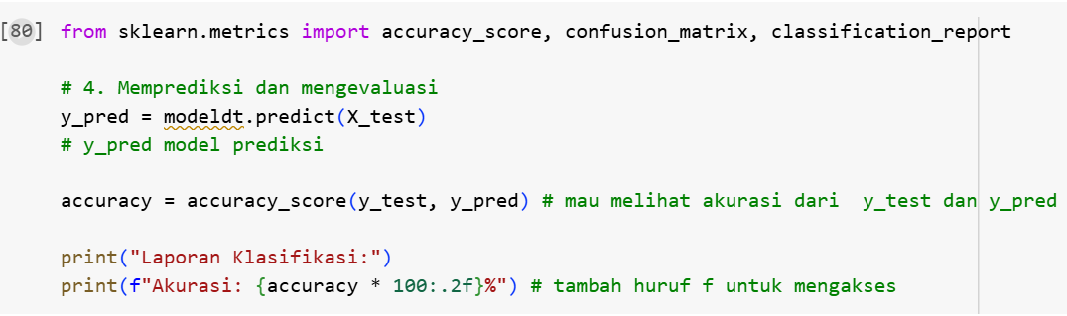

Predict & Evaluate
The Predict & Evaluate step is performed to assess the model's performance after it has been trained. The model is used to predict the labels of the test data using model.predict(X_test). These predictions are then compared with the true labels using accuracy_score(y_test, y_pred) to calculate the accuracy. In this case, the model achieved 98.89% accuracy, indicating that it successfully classified all the test data correctly

Slide 14
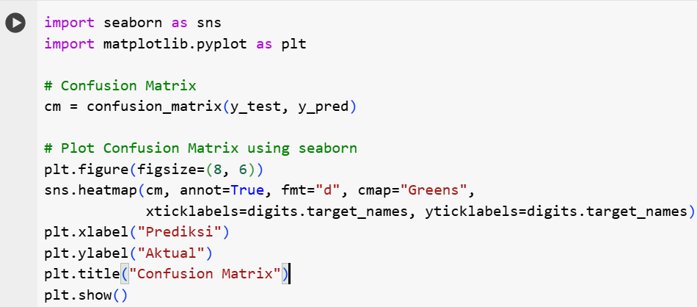
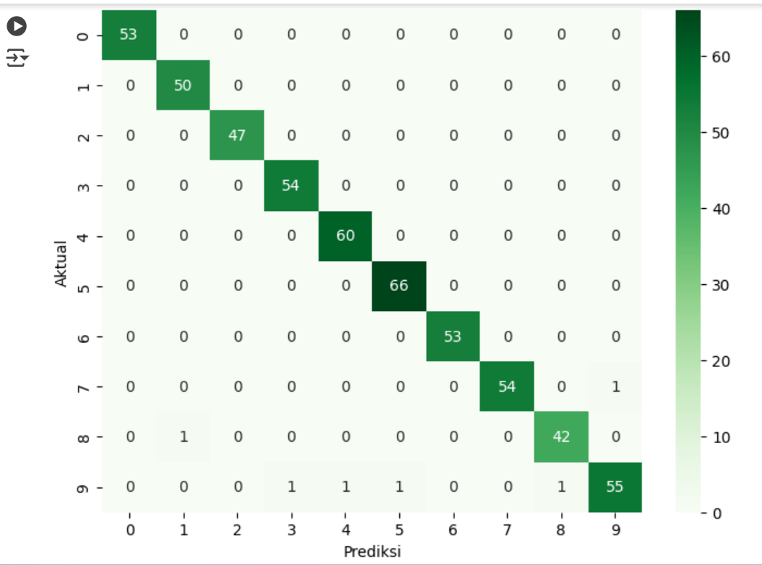
Predict & Evaluate
Confusion Matrix

Slide 15
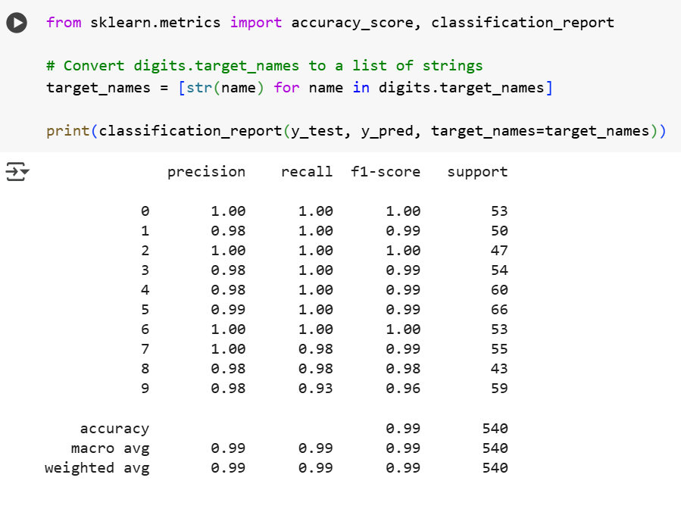
Predict & Evaluate

Slide 16
Thank You

